Slide 1
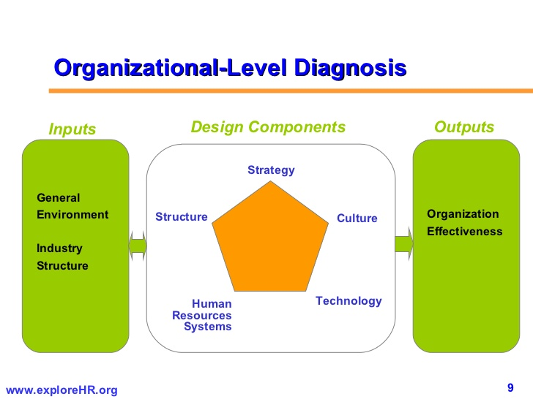
OC 6443
Change Leadership Methods and Models
Week 2
Inquiry: Diagnosis; Action Research; Action Learning

Slide 2
Diagnosis Defined
Diagnosis is a collaborative process between organizational members and the OD consultant to collect pertinent information, analyze it, and draw conclusions for action planning and intervention.

Slide 3
SYSTEMS THEORY

Slide 4
What is a system?
A system is a set of objects or elements that interact to achieve a specific goal .
A system is more than the sum of it's parts; it's properties emerge from the relationship among it's parts and from the system's relationship to its environment
Systems are arranged hierarchically, so every system is a super system for systems contained within it and a subsystem for systems containing it
All systems are more or less similar
What do systems do?
The function of a system is to convert information, energy, or materials into a planned outcome or product for use within the system, outside the system or both.

Slide 5
Types of systems
Systems differ from each other related to degree of self-sufficiency, complexity, and adaptability.
Closed systems have fixed relationships among system components and no interaction with the environment. Not really of concern to IT.
Open systems interact with their environment, have dynamic interaction of components, and can be self-regulating.
Human organizations are open systems; boundaries are permeable, continually engage in importing, transforming, and exporting matter, energy, information, and people; Human organisations are at the high end of the complexity scale due to these characteristics.

Slide 6
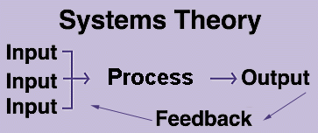
What are the basic elements of any system?
goal
environment
control
input
process
output
feedback.

Slide 7
Systems Theory
Synergy
Interdependence
Interconnections
within the organization
between the organization and the environment
Organization as ORGANISM
“A set of elements standing in inter-relations”

Slide 8
The Organization as an Open System
Input Stage
Raw
Materials
Conversion
Stage
Machines
Human skills
Output
Stage
Goods
Services
Sales of outputs
Firm can then buy inputs

Slide 9
The Learning Organization
Adaptive (single-loop) Learning
Involves coping with a situation
Limited by the scope of current organizational assumptions
Occurs when a mismatch between action and outcome is corrected without changing the underlying values of the system that enabled the mismatch.
Generative (double-loop) Learning
Moves from COPING to CREATING an improved organizational reality
Necessary for eventual survival of the organization
Both are Central Features of the Model of the Communicative Organization
Synergy and Nonsummativity are Important

Slide 10
The Learning Organization
Through communication, teams are able to learn more than individuals operating alone.
Critics argue that teams inhibit learning
Thoughts?
Leadership is a key element in creating and sustaining a learning organization.
Leaders are responsible for promoting an atmosphere conducive to learning
CREATIVE TENSION
Represents difference between the “vision” of where the organization could be and the reality of the current organizational situation.

Slide 11
Impediments to Learning Organization
Complexity of the Environment
Difficult to determine cause and effect
Multiple contributing elements in complex environments
Internal Conflicts
Individuals, teams, departments, and subcultures are often at odds
Energy is drained by conflict
Organization members must be trained in communication and conflict-negotiation skills

Slide 12
Conclusion
The importance of studying the organization’s external environment became clear in the 1960s.
A main focus of such research was to find methods to help managers improve the ways they use organizational resources and compete successfully in the global environment.

Slide 13
Organizational Diagnosis

Slide 14
Open Systems Model
Environment
Inputs
Information
Energy
People
Transformations
Social Component
Technological
Component
Outputs
Goods
Services
Ideas
Feedback

Slide 15
Key Features of the Model
Environments affect inputs, internal operations, & outputs
Organizational inputs can be used as inputs for maintenance and growth
Organizations are influenced by members as well as environments
System elements are interrelated and influence each other

Slide 16
Key Feature, Continued
Organizations are constantly changing
Organizational success depends on ability to adapt to or to final a favorable environment, tie people into their organizational roles, and manage operations
Any level or unit within an organization can be viewed as a system

Slide 17
Organization-Level
Diagnostic Model
Inputs
Design Components
Outputs
General
Environment
Industry
Structure
Technology
Strategy Structure
HR Measurement
Systems Systems
Organization
Effectiveness
Culture

Slide 18
Model for Organizational Diagnosis

Slide 19
Key Alignment Questions
Do the Design Components fit with the Inputs?
Are the Design Components internal consistent? Do they fit and mutually support each other?

Slide 20
Organization-Level Inputs
General Environment
External forces that can directly or indirectly affect the attainment of organizational objectives
Social, technological, ecological, economic, and political factors
Industry Structure
External forces (task environment) that can directly affect the organization
Customers, suppliers, substitute products, new entrants, and rivalry among competitors

Slide 21
Organization Design Components
Strategy
the way an organization uses its resources (human, economic, or technical) to gain and sustain a competitive advantage
Structure
how attention and resources are focused on task accomplishment
Technology
the way an organization converts inputs into products and services

Slide 22
Organization Design Components
Human Resource Systems
the mechanisms for selecting, developing, appraising, and rewarding organization members
Measurement Systems
methods of gathering, assessing, and disseminating information on the activities of groups and individuals in organizations

Slide 23
Organization Design Components
Organization Culture
The basic assumptions, values, and norms shared by organization members
Represents both an “outcome” of organization design and a “foundation” or “constraint” to change

Slide 24
Outputs
Organization Performance
e.g., profits, profitability, stock price
Productivity
e.g., cost/employee, cost/unit, error rates, quality
Stakeholder Satisfaction
e.g., market share, employee satisfaction, regulation compliance

Slide 25
Data for Organizational Level Diagnosis
Environmental data
Industry structure data
Goals & strategies
Organizational design & structure
Organizational performance
Productivity
Stakeholder satisfaction

Slide 26
The Process
Diagnosis is cyclical process involving:
Data gathering.
Identification of problem areas.
Interpretation.
Potential action programs.

Slide 27
Steps in Diagnosis
Step 1: Tentative problem identified.
Step 2: Collect data.
Step 3: Analyze data.
Step 4: Feedback data.
Step 5: More data needed?
Step 6: Problem areas identified.
Step 7: Is client motivated?
Step 8: Diagnosis and work on problem.
Step 9: Monitor and assess results.

Slide 28
Types of Data-Gathering Methods
Secondary sources.
Organization and industry data.
Employee surveys or questionnaires.
Useful with a large number of people.
Data may lack “richness.”
Direct observation.
Observing how people go about tasks.
Interviews.
Direct, personal, and flexible.
One of most widely used methods.
Directed interview.
Nondirected interview.

Slide 29
Analysis of Data
Techniques used to analyze data.
Dictated by method used to gather data.
Type of analysis decided prior to data collection.

Slide 30
Guidelines for Evaluating Effectiveness of Data Collection
Validity of data.
Time to collect data.
Cost of data collection.
Organization culture and norms.
Hawthorne effect in data collecting.

Slide 31
Diagnostic Models
Models may be used to:
Analyze structure, culture, and behavior of organization.
Models play a critical role.
Provide conceptual framework to understand organization.

Slide 32
Warning Signs in Diagnosis
Confidentiality of data.
Over-diagnosis.
Crisis diagnosis.
Threatening and overwhelming diagnosis.
Practitioner’s favorite diagnosis.
Diagnosis of symptoms, not problems.

Slide 33
Action Research/Learning

Slide 34
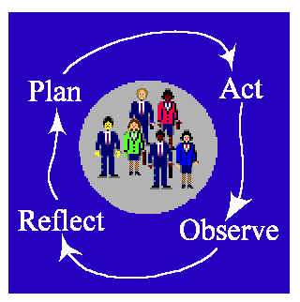
Action Research

Slide 35
What is Action Research?
Definition
Action research is known by many other names, including participatory research, collaborative inquiry, emancipatory research, action learning, and contextual action research, but all are variations on a theme.
Put simply, action research is “learning by doing” - a group of people identify a problem, do something to resolve it, see how successful their efforts were, and if not satisfied, try again.
While this is the essence of the approach, there are other key attributes of action research that differentiate it from common problem-solving activities that we all engage in every day.

Slide 36
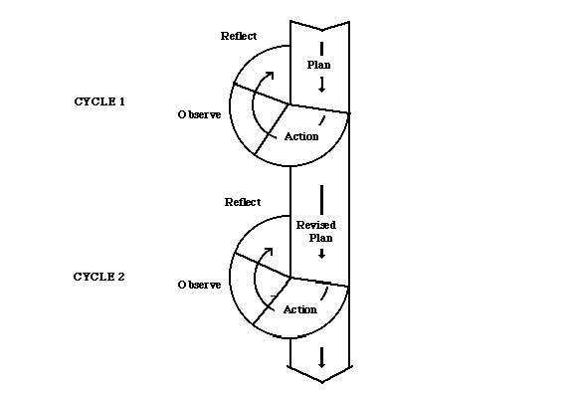
Simple Action Research Model

Slide 37
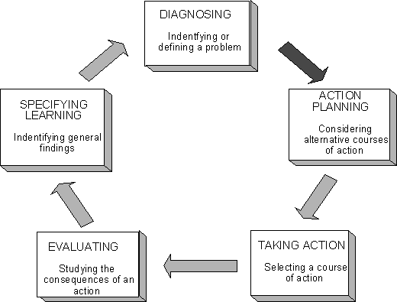
Detailed Action Research Model

Slide 38
Action Research Model
Problem Identification
Joint diagnosis
Consultation with a
behavioral scientist
Joint action planning
Data gathering &
preliminary diagnosis
Action
Data gathering after action
Feedback to Client

Slide 39
Principles of Action Research
What gives action research its unique flavor is the set of principles that guide the research.
Winter (1989) provides a comprehensive overview of six key principles.

Slide 40
Reflexive critique
An account of a situation, such as notes, transcripts or official documents, will make implicit claims to be authoritative, i.e., it implies that it is factual and true.
Dialectical critique
Phenomena are conceptualized in dialogue, therefore a dialectical critique is required to understand the set of relationships both between the phenomenon and its context, and between the elements constituting the phenomenon.
Collaborative Resource
The principle of collaborative resource presupposes that each person’s ideas are equally significant as potential resources for creating interpretive categories of analysis, negotiated among the participants.

Slide 41
Risk
The change process potentially threatens all previously established ways of doing things, thus creating psychic fears among the practitioners.
Initiators of action research will use this principle to allay others’ fears and invite participation by pointing out that they, too, will be subject to the same process, and that whatever the outcome, learning will take place.
Plural Structure
The nature of the research embodies a multiplicity of views, commentaries and critiques, leading to multiple possible actions and interpretations.
This means that there will be many accounts made explicit, with commentaries on their contradictions, and a range of options for action presented.
Theory, Practice, Transformation
For action researchers, theory informs practice, practice refines theory, in a continuous transformation.

Slide 42
When is Action Research used?
Action research is used in real situations, rather than in contrived, experimental studies, since its primary focus is on solving real problems.
It can, however, be used by social scientists for preliminary or pilot research, especially when the situation is too ambiguous to frame a precise research question.
Mostly, though, in accordance with its principles, it is chosen when circumstances require flexibility, the involvement of the people in the research, or change must take place quickly or holistically.

Slide 43
When used (Cont’d)?
It is often the case that those who apply this approach are practitioners who wish to improve understanding of their practice,
social change activists trying to mount an action campaign, or, more likely,
academics who have been invited into an organization (or other domain) by decision-makers aware of a problem requiring action research, but lacking the requisite methodological knowledge to deal with it.

Slide 44
Current Types of Action Research
By the mid-1970s, the field had evolved, revealing 4 main ‘streams’ that had emerged:
traditional,
contextural (action learning),
radical, and
educational action research.

Slide 45
Traditional Action Research
Traditional Action Research stemmed from Lewin’s work within organizations and encompasses the concepts and practices of Field Theory, Group Dynamics, T-Groups, and the Clinical Model.
The growing importance of labor-management relations led to the application of action research in the areas of Organization Development, Quality of Working Life (QWL), Socio-technical systems (e.g., Information Systems), and Organizational Democracy.
This traditional approach tends toward the conservative, generally maintaining the status quo with regards to organizational power structures.

Slide 46
Contextural Action Research (Action Learning)
Contextural Action Research, also sometimes referred to as Action Learning, is an approach derived from Trist’s work on relations between organizations.
It is contextural, insofar as it entails reconstituting the structural relations among actors in a social environment; domain-based, in that it tries to involve all affected parties and stakeholders; holographic, as each participant understands the working of the whole; and it stresses that participants act as project designers and co-researchers.
The concept of organizational ecology, and the use of search conferences come out of contextural action research, which is more of a liberal philosophy, with social transformation occurring by consensus and normative incrementalism.

Slide 47
Radical Action Research
The Radical stream, which has its roots in Marxian ‘dialectical materialism’ and the praxis orientations of Antonio Gramsci, has a strong focus on emancipation and the overcoming of power imbalances.
Participatory Action Research, often found in liberationist movements and international development circles, and Feminist Action Research both strive for social transformation via an advocacy process to strengthen peripheral groups in society.

Slide 48
Educational Action Research
A fourth stream, that of Educational Action Research, has its foundations in the writings of John Dewey, the great American educational philosopher of the 1920s and 30s, who believed that professional educators should become involved in community problem-solving.
Its practitioners, not surprisingly, operate mainly out of educational institutions, and focus on development of curriculum, professional development, and applying learning in a social context.
It is often the case that university-based action researchers work with primary and secondary school teachers and students on community projects.

Slide 49
Action Research Sites
http://www.web.net/~robrien/papers/arfinal.html#_Toc26184654
http://carbon.cudenver.edu/~mryder/itc/act_res.html
http://carbon.cudenver.edu/~mryder/coss.html#arr
http://carbon.cudenver.edu/~mryder/itc/pract_res.html

Slide 50

PAU!

Slide 51
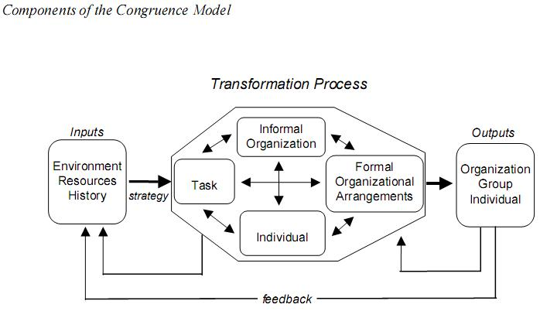

Slide 52
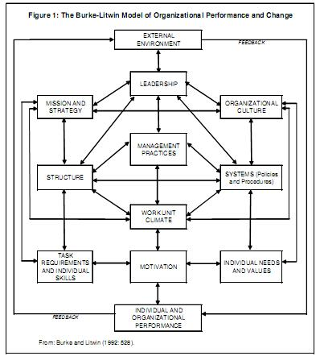

Slide 53
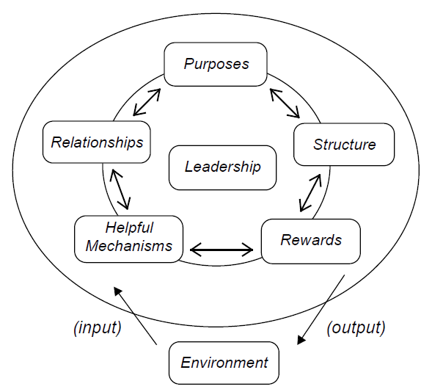

Slide 54
